Slide 1
QUEUE THEORY-PART-2

Slide 2
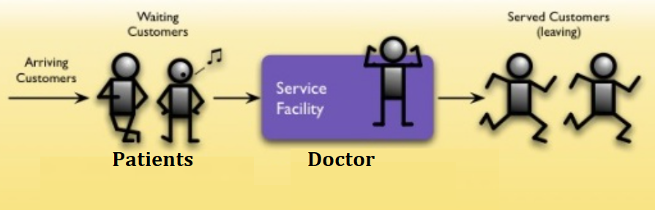
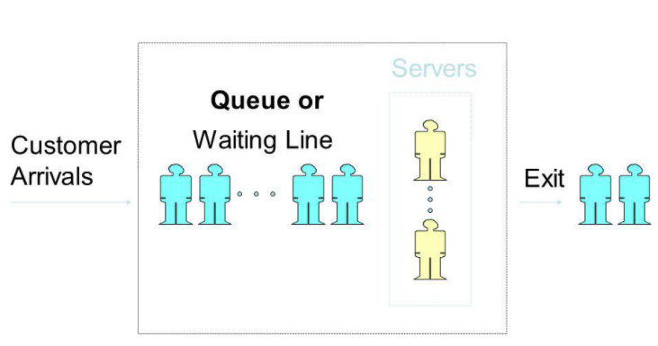
Components of Queuing System
Waiting Customers OR Entries
Waiting Lines OR Queue
Service Facility OR Service Channels

Slide 3
Service Time of Queue
The difference between completion time and the starting time is called the service time.
Example: A patient come in the hospital and join the line (Starting Time). Patient finally checked by Doctor is called Completion time.
Service Time = Completion Time (10 pm) – Starting Time (8 pm) = 02 hours (After 02 hours patient check by Doctor

Slide 4
QUIZ-1: Design a Queuing System of Khuzdar Hospital and shows the arrival process of patients, Queue of Patients, Queue Length, Doctors (Servers) and Exit Process.

Slide 5
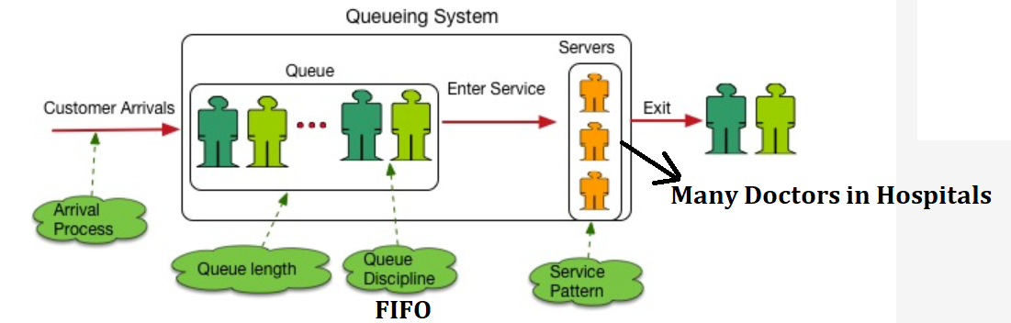
SOLUTION OF QUIZ-1

Slide 6
QUIZ-2: Design a Queuing System of Mechanical system or any manufacturing system and shows the arrival process of patients, Queue of Patients, Queue Length, Doctors (Servers) and Exit Process.

Slide 7
QUIZ-3: Fill the Information Regarding Waiting Line
Situation | Arrivals | Servers | Service Process
Doctor’s Clinic
Bank
Traffic Intersection
Assembly Line

Slide 8
QUIZ-3: Fill the Information Regarding Waiting Line
Situation | Arrivals | Servers | Service Process
Doctor’s Clinic | Patient | Doctor | Treatment
Bank | Customer | Teller | Deposit etc
Traffic Intersection | Cars | Light | Controlled Passage
Assembly Line | Parts | Workers | Assembly

